Slide 1
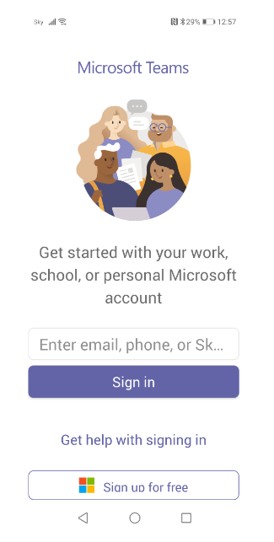
xxxxxx@student.cavc.ac.uk
Click/Dhagsii

Slide 2
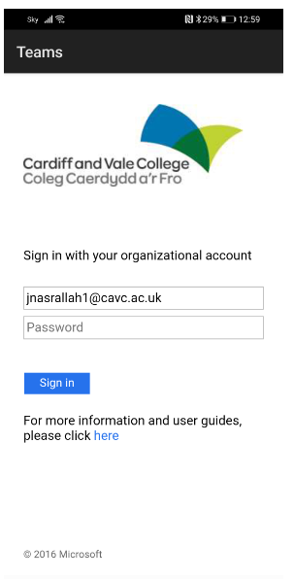
xxxxxx@student.cavc.ac.uk
Enter password/Geli erayga sirta ah
Click/Dhagsii

Slide 3
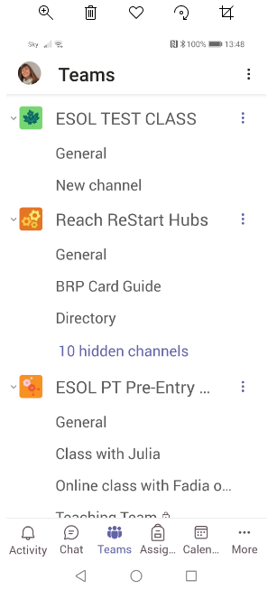
Click on your class/
Dhag kusii fasalkaaga
Click on Teams/
Dhag kusii teams

Slide 4
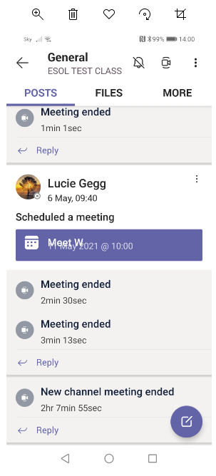
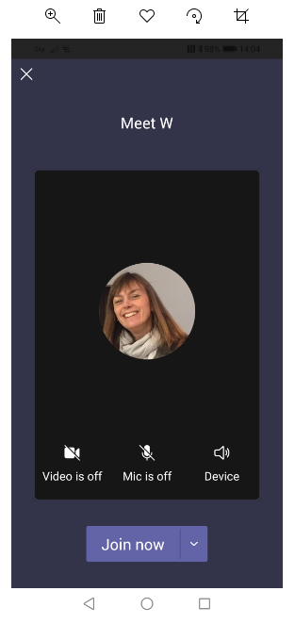
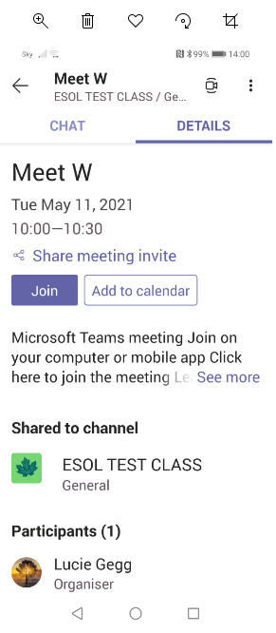
To join a meeting – phone/Kubiir kulanka talefanka
Click 1/Dhagsii
Click 2/Dhagsii
Click 3/Dhagsii

Slide 5
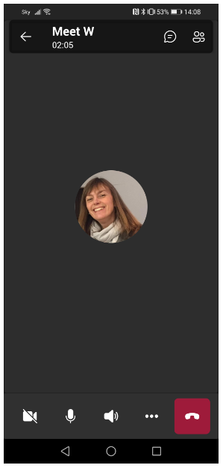
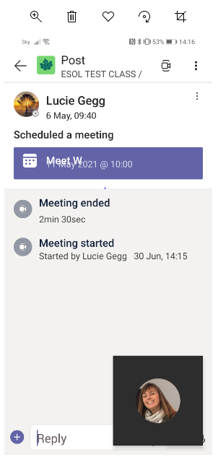
Chat/wadahadal
Camera on/off/
Kamarad shidan\xiran
Mute/unmute/
Codka furan\xiran
Type/ qor
End call/ Dhamaadka wicitaanka

Slide 6
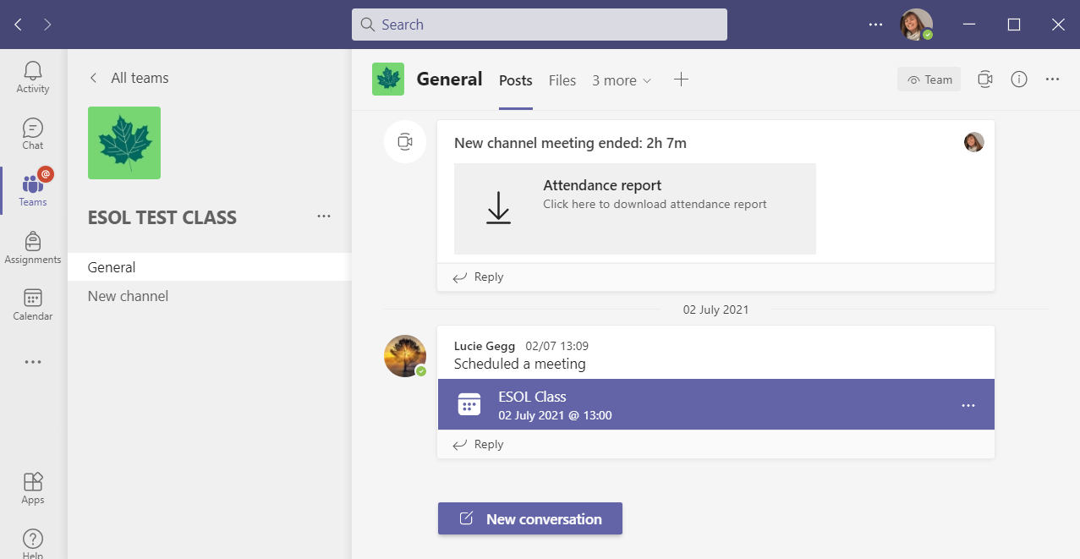
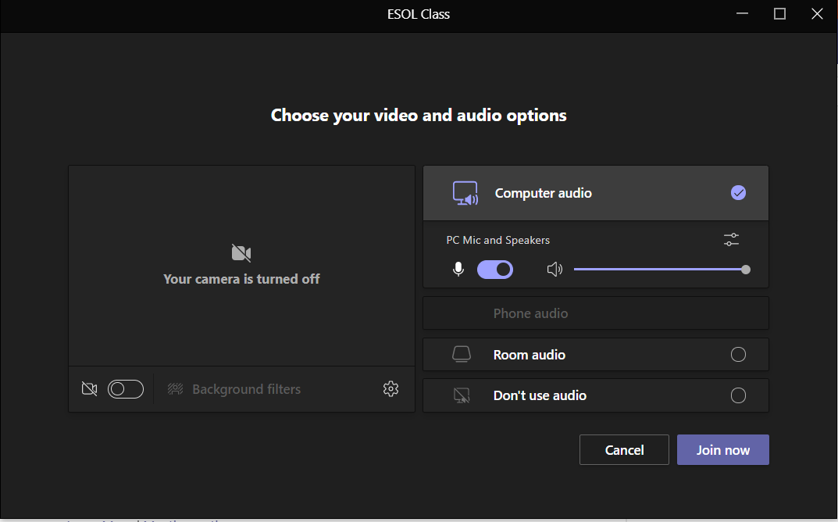
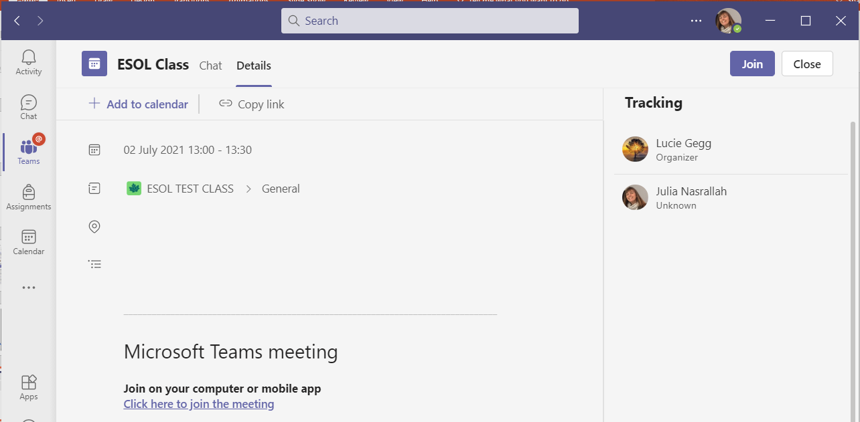
To join a call – laptop/Kubiir kulanka laptopka
Click 1/ Dhagsii
Click 2/ Dhagsii
Click 3/ Dhagsii

Slide 7
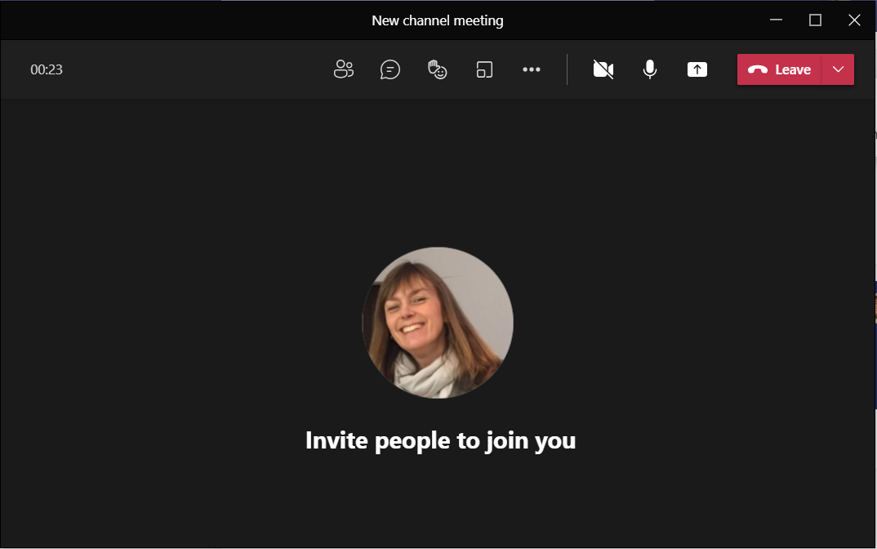
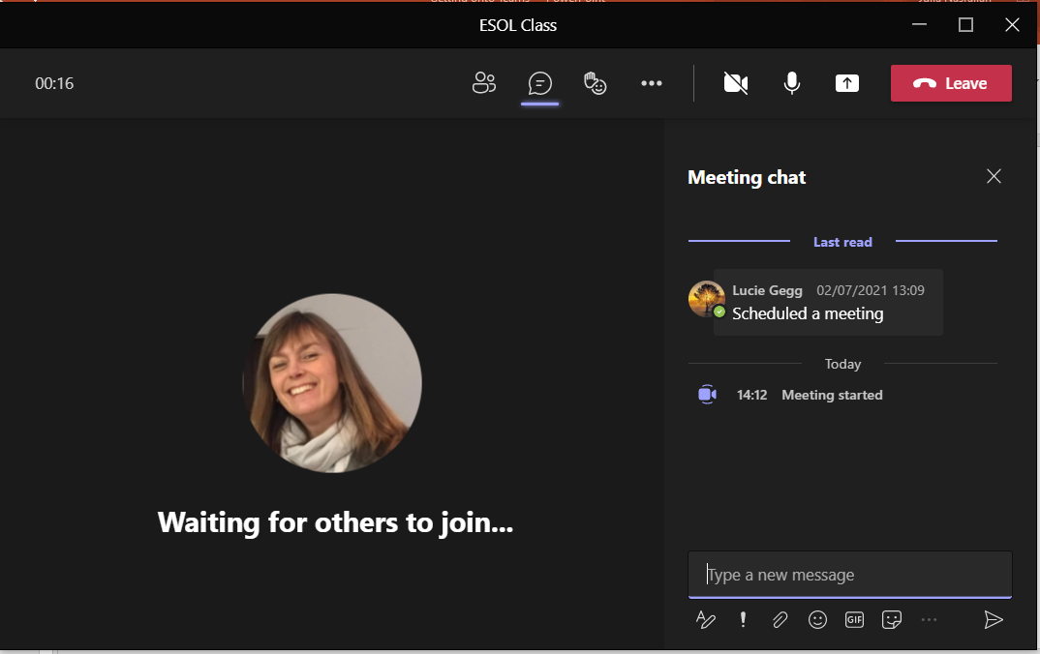
Camera on/off/Kamarad shidan\xiran
Chat/wadahadal
Mute/unmute/Codka furan\xiran
End call/ Dhamaadka wicitaanka
Type/ qor

